Slide 1
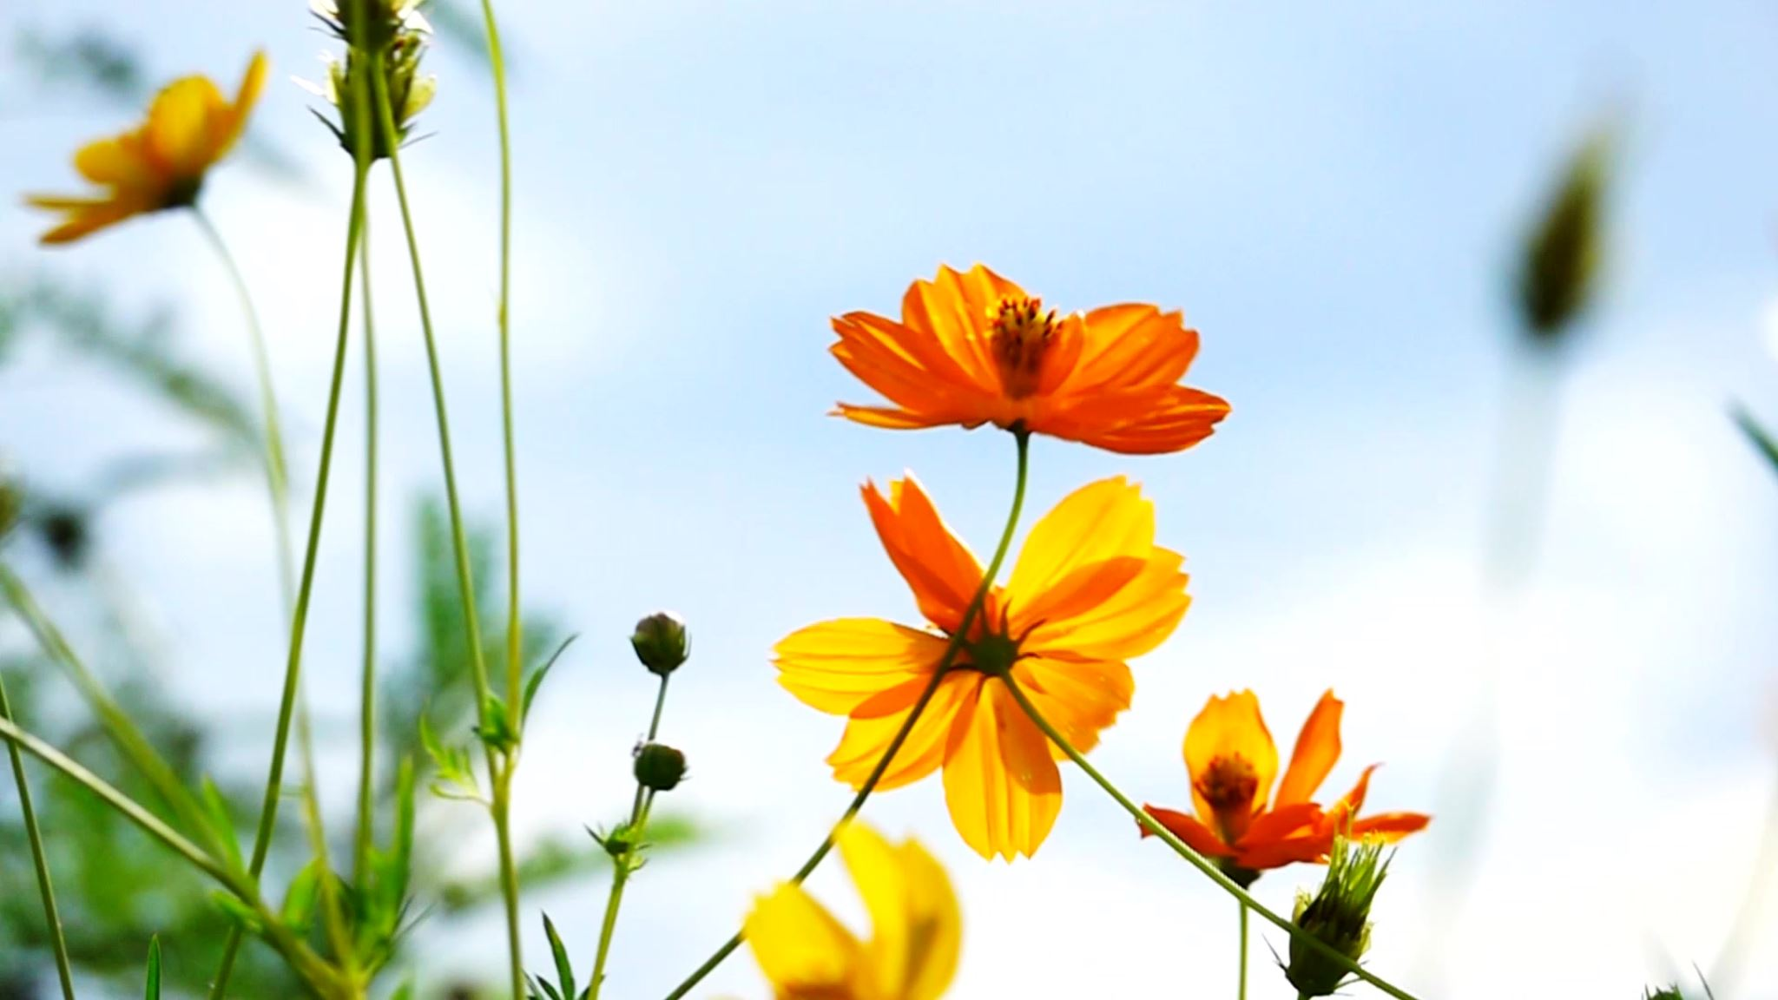
OPTIMIZING FLOWER RECOGNITION: EXPLORING MACHINE LEARNING FOR FLOWER RECOGNITION AT ALLIANCE UNIVERSITY
-Mrs. Karpaga Lakshmi, Associate Professor
Mansi Mishra, Mary Chaitra, Sonal Binji
M.Sc. Data Science
Alliance School of Applied Mathematics
Alliance University, Bangalore

Slide 2
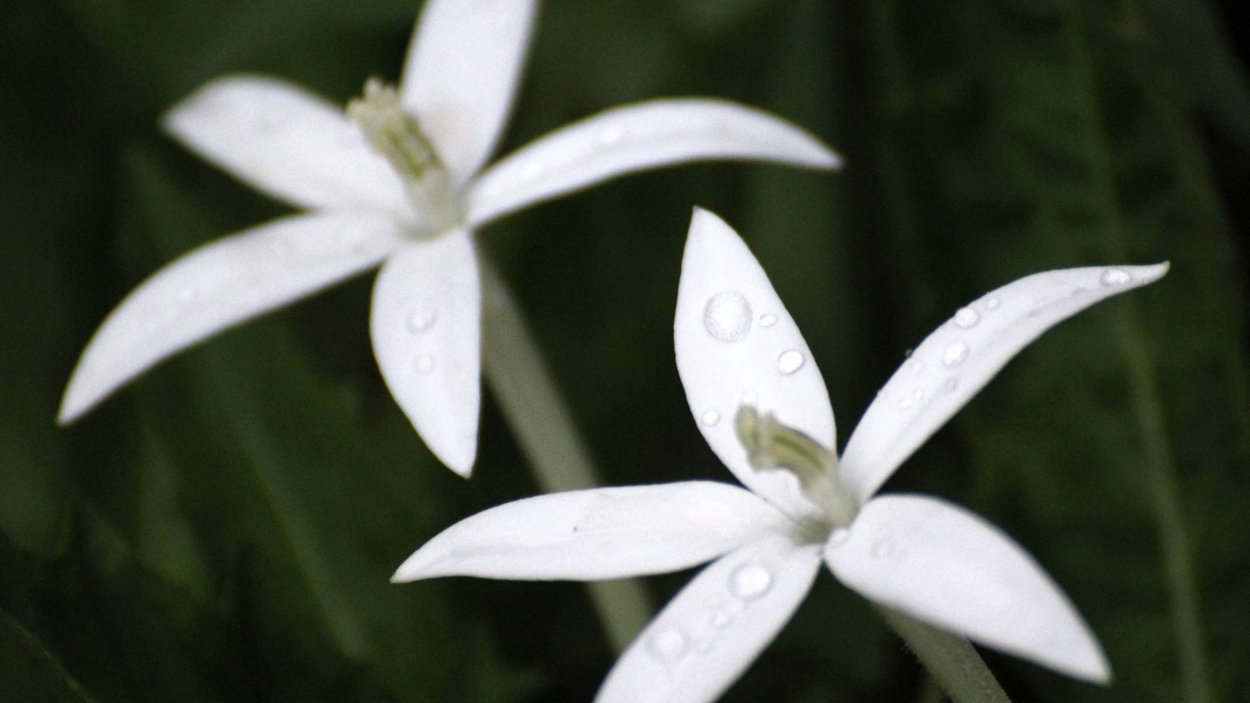
Abstract
The abstract delves into the realm of image classification through machine learning, with a specific emphasis on categorizing various species of flowers. It highlights the utilization of convolutional neural networks (CNNs) as a pivotal tool in this endeavor, aiming to enhance precision in flower recognition. The integration of machine learning classifiers further refines the accuracy of the classification process. Keywords associated with this research include flower identification, convolutional neural networks, and machine learning classifiers.

Slide 3
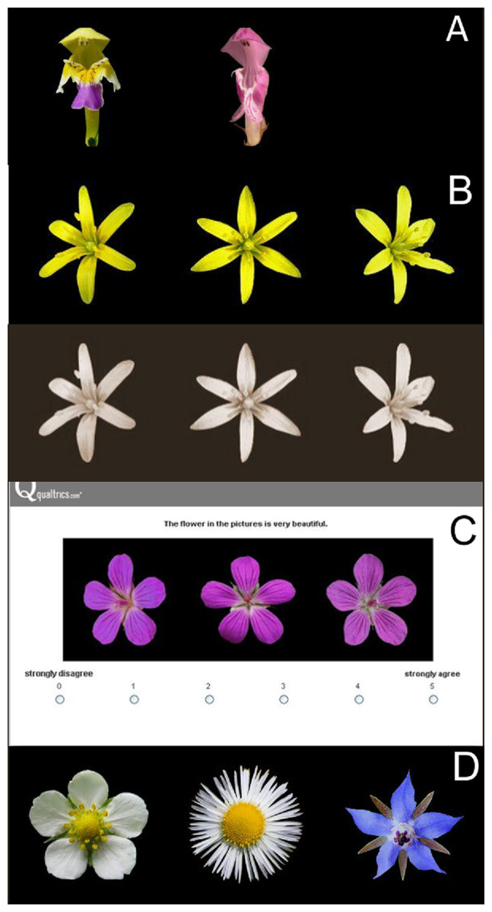
Introduction
We recognize the significance of flower recognition across agriculture, environmental conservation, and botanical studies. However, challenges arise from manual inspection by specialists and the vast diversity of flower species. Machine learning, especially convolutional neural networks (CNNs), offers a solution by enabling precise flower species detection and developing robust classifiers trained on extensive datasets. At Alliance University, research efforts leverage faculty expertise and resources, fostering interdisciplinary collaboration to address these challenges effectively.

Slide 4

Literature Review
Recent advancements in flower recognition have seen a significant integration of image processing with deep learning techniques, marking a notable shift in approach. Several studies have focused on enhancing flower recognition systems through this integration. These endeavors have led to improved accuracy and robustness in identifying flowers across various datasets. Moreover, the applications of these advancements span diverse fields, highlighting the versatility and potential impact of this technology beyond botanical studies.

Slide 5
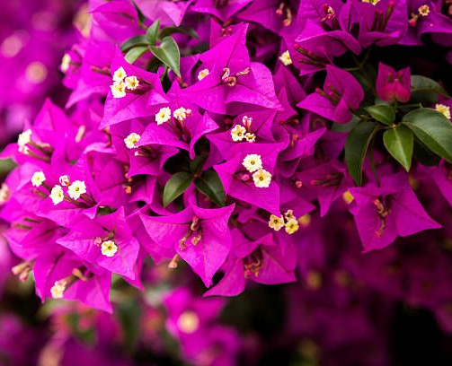
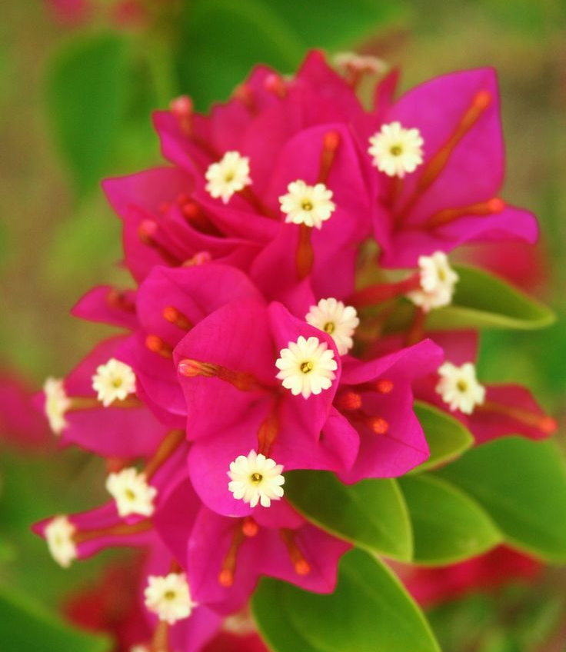
Bougainvillea
Bougainvillea, a genus comprising ornamental vines, bushes, and trees primarily found in eastern South America, showcases vibrant inflorescences with bracts encircling the flowers, adding to its aesthetic appeal.
Potential Medical Uses:
Anti-inflammatory Properties: Bougainvillea exhibits anti-inflammatory properties that may help alleviate inflammation-related conditions.
Antioxidant Effects: The plant's components offer antioxidant effects, which can neutralize harmful free radicals and promote overall health.
Wound Healing Properties: Bougainvillea possesses properties conducive to wound healing, aiding in the regeneration of damaged tissues.
Treatment for Digestive Disorders: Certain compounds in Bougainvillea may be beneficial for managing digestive disorders and promoting gastrointestinal health.
Management of Respiratory Conditions: Bougainvillea's medicinal properties extend to respiratory health, potentially aiding in the management of conditions affecting the respiratory system.

Slide 6
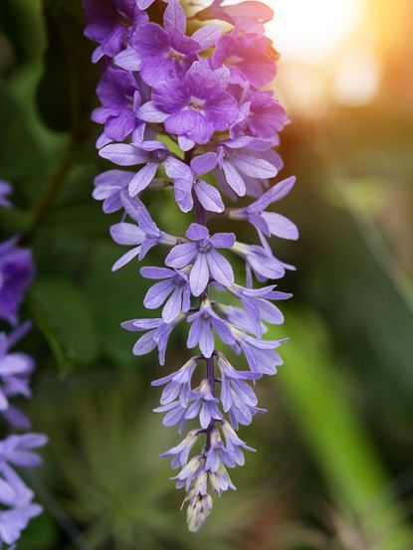
Purple Wreath
Purple Wreath, an evergreen flowering vine native to Tropical America, boasts racemose inflorescences adorned with striking violet flowers, making it visually captivating. This slide delves into potential medicinal applications associated with Purple Wreath.
Potential Medical Uses:
Treatment of Skin Conditions: Its extracts are believed to possess properties beneficial for treating skin ailments like eczema and dermatitis.
Anti-inflammatory Effects: Compounds found in Purple Wreath may help reduce inflammation, potentially aiding in the management of inflammatory conditions.
Antioxidant Properties: Purple Wreath extracts contain antioxidants that can help neutralize free radicals, offering potential benefits for overall health and disease prevention.
Wound Healing: Certain components of Purple Wreath may promote wound healing and tissue regeneration, making it useful in topical treatments for cuts and wounds.
Antimicrobial Activity: Studies suggest that Purple Wreath extracts may exhibit antimicrobial properties, which could be beneficial for combating bacterial and fungal infections.

Slide 7
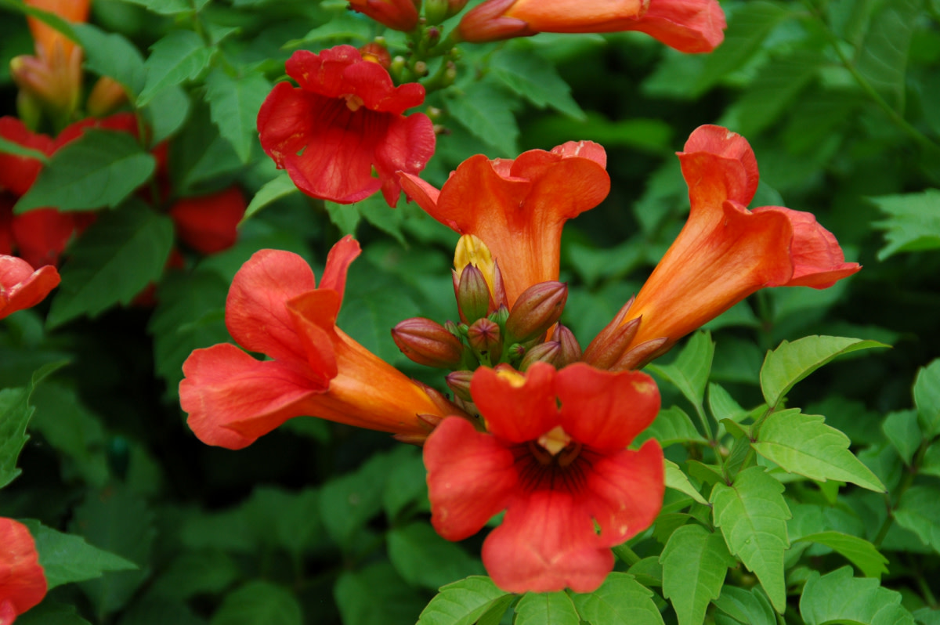
Trumpet
Trumpet, a medium-sized deciduous tree renowned for its bright pink to magenta tubular flowers, is native to Central and South America. Its floral display is visually striking, adding to its allure. This slide also explores potential medicinal properties linked to Trumpet.
Potential Medical Uses:
Treatment of Respiratory Conditions: Trumpet may be utilized in the treatment of respiratory conditions, offering relief and support for respiratory health.
Management of Inflammation and Pain: The plant's components may have anti-inflammatory properties, potentially aiding in the management of inflammation and pain.
Antioxidant Properties: Trumpet exhibits antioxidant properties that can help neutralize free radicals, promoting overall health and well-being.
Support for Cardiovascular Health: Certain compounds found in Trumpet may support cardiovascular health, contributing to heart health and function.

Slide 8
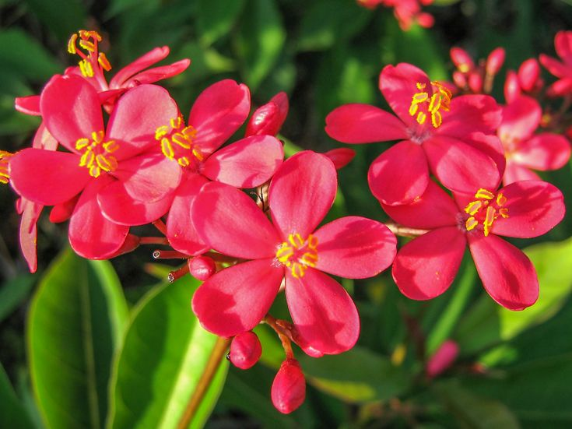
Peregrina
Peregrina is an evergreen shrub or small tree characterized by glossy leaves and star-shaped red, pink, or vermilion flowers. Originating from Cuba but cultivated worldwide, Peregrina's aesthetic and potential medicinal benefits are explored in this slide.
Potential Medicinal Uses:
Treatment of Skin Conditions: Peregrina's extracts may have properties beneficial for treating skin conditions like rashes or irritations.
Anti-inflammatory Effects: Compounds found in Peregrina may possess anti-inflammatory properties, making it useful for alleviating inflammation-related ailments.
Analgesic Properties: Peregrina extracts might exhibit analgesic effects, potentially aiding in pain relief.
Traditional Medicine: In various cultures, Peregrina has been used in traditional medicine to treat a range of ailments, including digestive issues and respiratory problems.

Slide 9
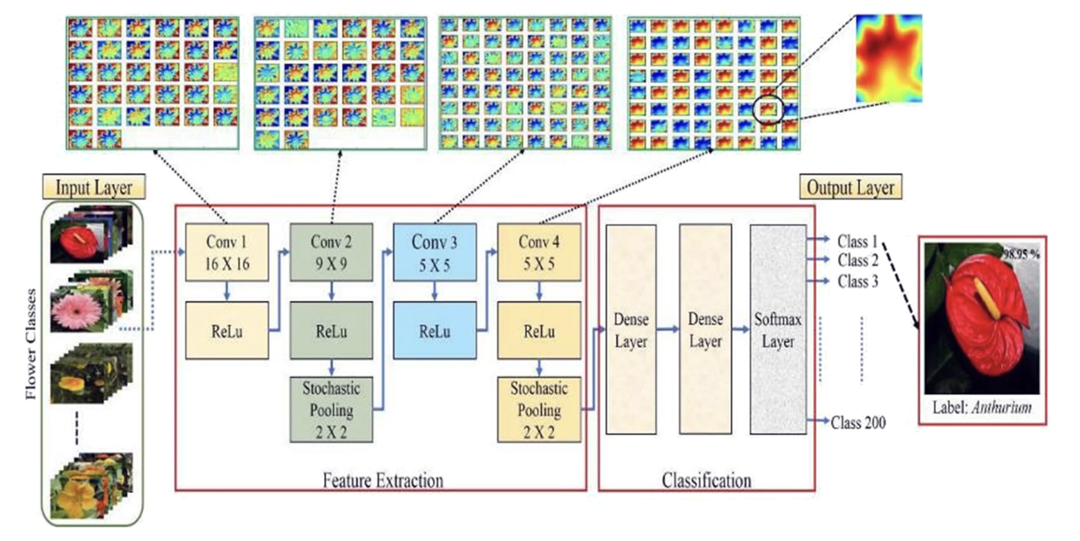
Model Explanation

Slide 10
Model Architecture
Convolutional Layers: The CNN starts with a series of convolutional layers designed to extract features from input flower images. These layers consist of filters that slide over the input image, detecting patterns such as edges, textures, and shapes.
Activation Functions: Rectified Linear Unit (ReLU) activation functions are applied after each convolutional layer to introduce non-linearity, allowing the model to capture complex relationships within the data.
Pooling Layers: Max-pooling layers follow the convolutional layers, reducing the spatial dimensions of the feature maps while retaining the most important information. This helps in reducing computational complexity and preventing overfitting.
Flattening: After several convolutional and pooling layers, the feature maps are flattened into a one-dimensional vector, preparing them for input into the fully connected layers.
Fully Connected Layers: Fully connected layers serve as the classifier, learning to map the extracted features to specific flower species. These layers integrate information from the entire image through connections to all neurons in the previous layer.
Output Layer: The output layer typically consists of neurons corresponding to the number of flower species being classified. The Softmax activation function is applied to produce probability distributions over the classes, indicating the likelihood of each flower species.

Slide 11

Training Workflow
Data Preprocessing: Flower images are preprocessed to standardize their size, enhance contrast, and normalize pixel values. Data augmentation techniques such as rotation, flipping, and scaling may also be applied to increase the diversity of training samples.
Model Compilation: Once the CNN architecture is defined, the model is compiled with appropriate loss functions (e.g., categorical cross-entropy), optimizers (e.g., Adam), and evaluation metrics (e.g., accuracy).
Training: The model is trained on a labeled dataset of flower images using backpropagation and gradient descent. During training, the weights of the CNN are adjusted iteratively to minimize the loss between predicted and actual labels.
Validation: Validation data is used to monitor the model's performance during training, preventing overfitting. The model's accuracy and loss metrics are evaluated on the validation set after each epoch.
Evaluation: Once training is complete, the model is evaluated on a separate test dataset to assess its generalization performance. The accuracy and other relevant metrics are computed to measure the model's effectiveness in classifying unseen flower images.

Slide 12
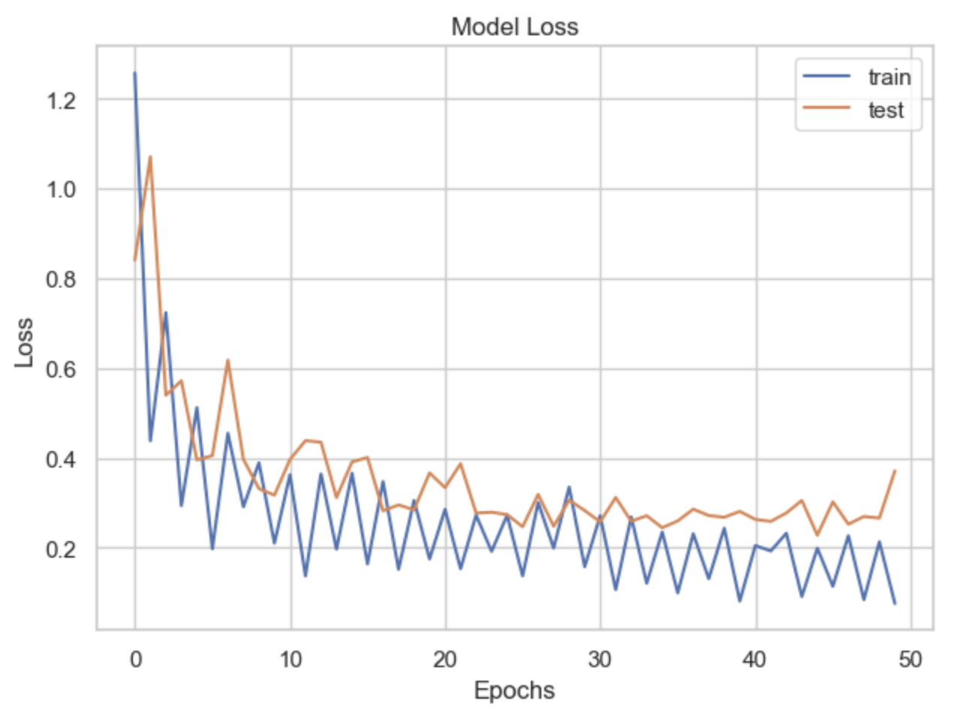
Loss Plot
X-axis: The number of epochs, representing the iterations of the training process.
Y-axis: The loss value, which quantifies the error between the model's predictions and the actual labels.
Training Loss: The loss computed on the training dataset during each epoch. It measures how well the model is fitting the training data.
Validation Loss: The loss computed on a separate validation dataset that the model hasn't seen during training. It indicates how well the model is generalizing to unseen data.
Interpretation:
Decreasing Loss: As training progresses, both training and validation loss typically decrease. This indicates that the model is learning to make better predictions.
Convergence: Ideally, both training and validation loss stabilize, indicating that the model has converged to its optimal performance.
Overfitting: If the training loss continues to decrease while the validation loss starts to increase or remains stagnant, it suggests that the model is overfitting to the training data.
Underfitting: High values of both training and validation loss suggest underfitting, indicating that the model is too simple to capture the patterns in the data.
Usage:
Performance Evaluation: The loss plot helps assess the performance of the model during training and detect any issues such as overfitting or underfitting.

Slide 13
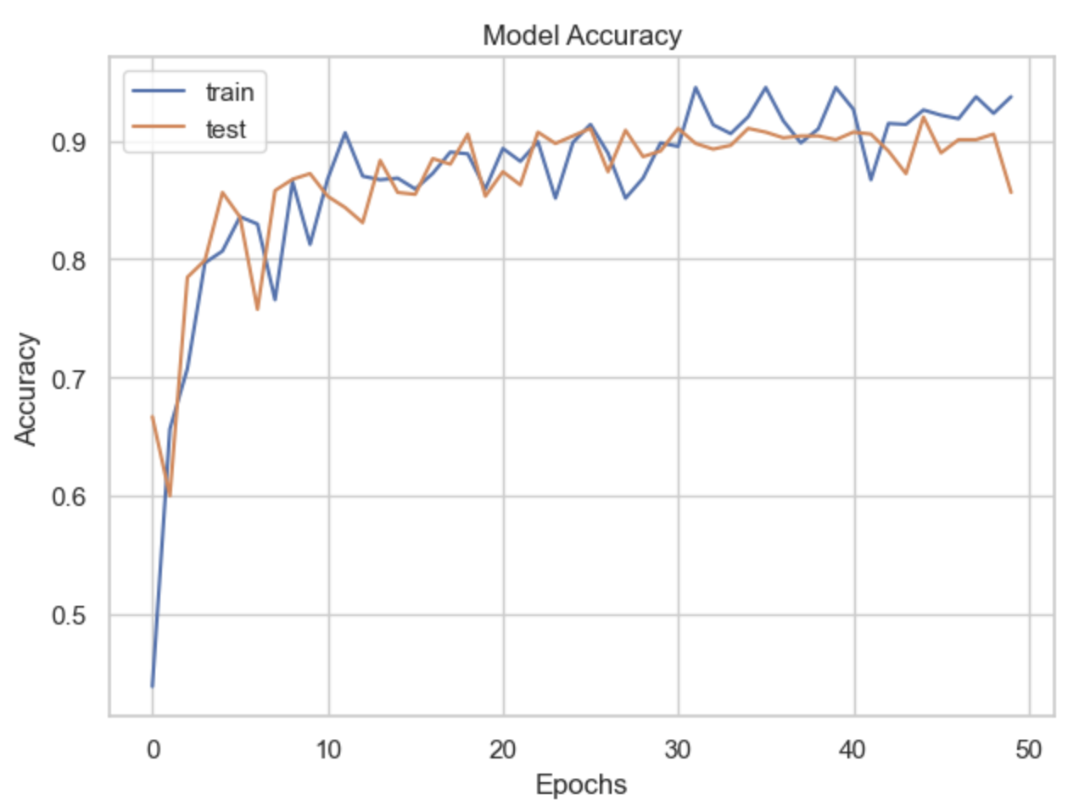
Accuracy Plot
X-axis: The number of epochs, representing the iterations of the training process.
Y-axis: The accuracy value, which measures the proportion of correctly classified images.
Training Accuracy: The accuracy computed on the training dataset during each epoch. It indicates how well the model is performing on the training data.
Validation Accuracy: The accuracy computed on a separate validation dataset that the model hasn't encountered during training. It reflects the model's ability to generalize to new, unseen data.
Interpretation:
Increasing Accuracy: As training progresses, both training and validation accuracy typically increase. This suggests that the model is improving its ability to classify images correctly.
Convergence: Ideally, both training and validation accuracy stabilize, indicating that the model has converged to its optimal performance.
Overfitting Detection: If the training accuracy continues to improve while the validation accuracy starts to decrease or remains stagnant, it indicates overfitting, where the model is memorizing the training data rather than learning generalizable patterns.
Underfitting Detection: Low values of both training and validation accuracy suggest underfitting, indicating that the model is too simple to capture the patterns in the data.
Usage:
Performance Assessment: The accuracy plot provides insights into how well the model is learning to classify flower images accurately.

Slide 14
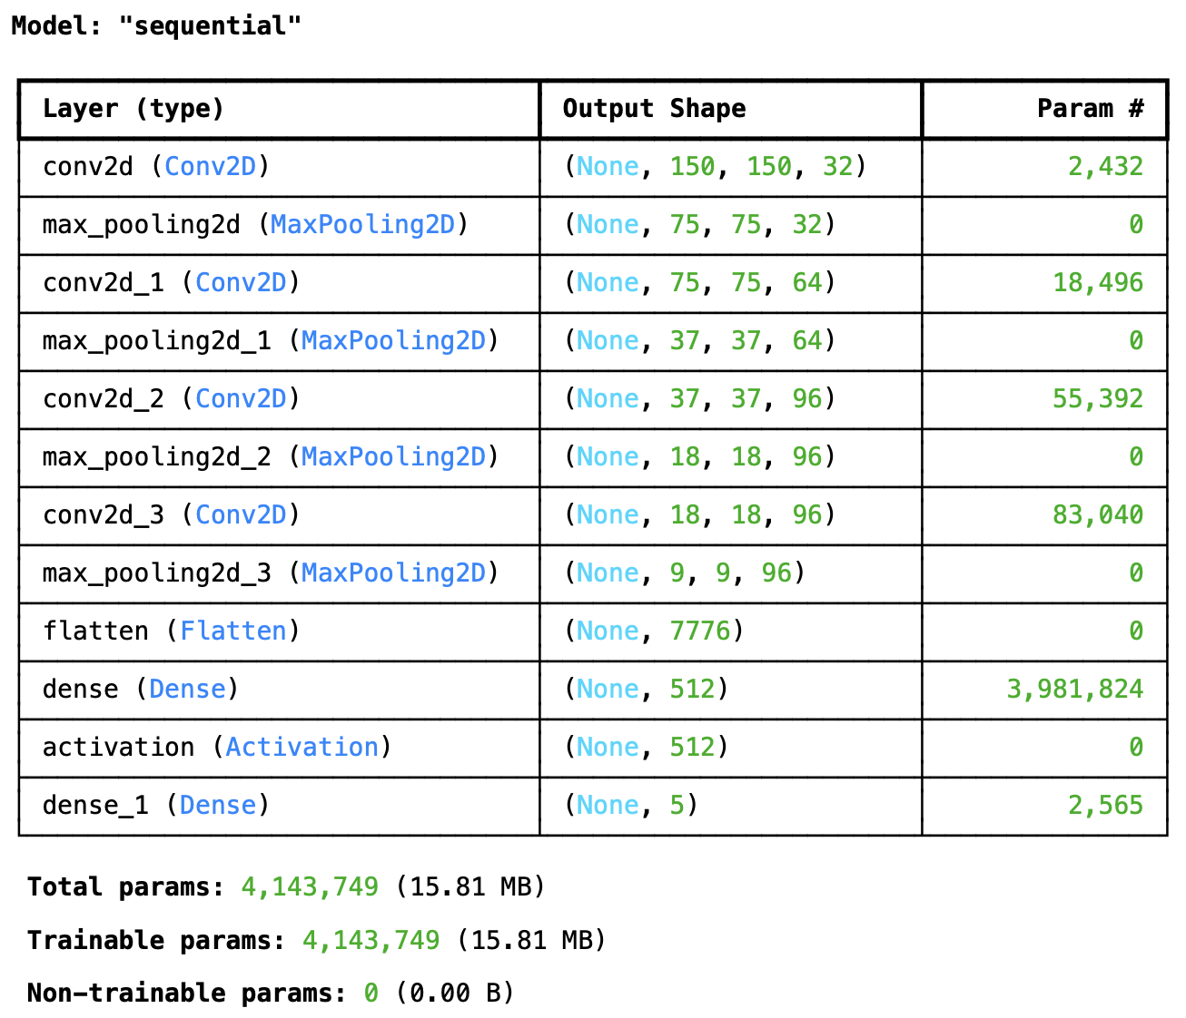
Model Summary
The model consists of three convolutional layers (Conv2D), each followed by a max-pooling layer (MaxPooling2D).
The output shape of the convolutional layers changes as the spatial dimensions are reduced due to pooling operations.
The Flatten layer converts the 2D feature maps into a 1D vector to be fed into the fully connected layers.
The model ends with two fully connected (Dense) layers, with the final layer having 5 units corresponding to the number of flower classes to be recognized.
The total number of trainable parameters in the model is 4,143,749.

Slide 15
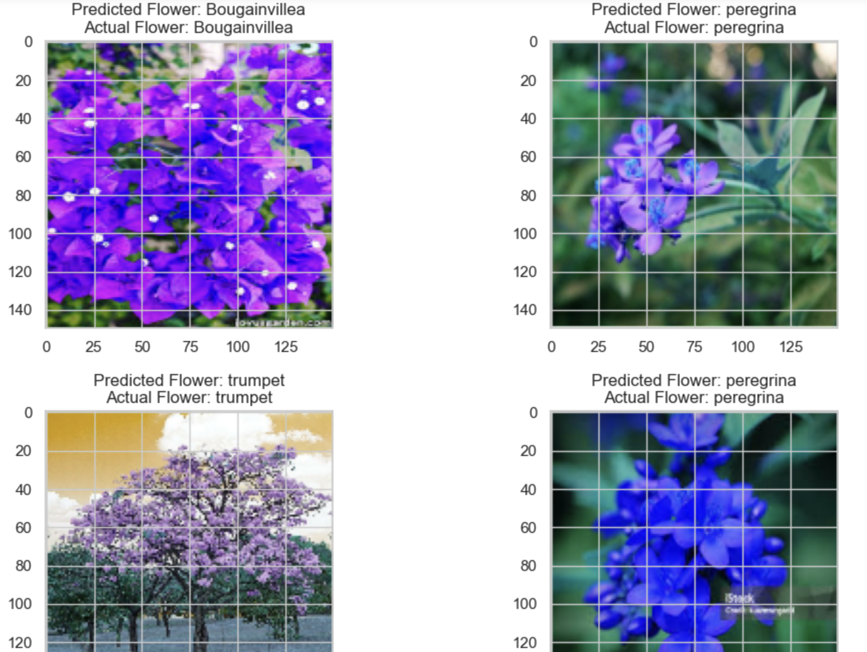
Conclusion
In summary, the literature review underscores a significant transition from traditional to deep learning frameworks in flower recognition, leading to unprecedented advancements in accuracy. Future research could prioritize refining models, exploring innovative architectures, and diversifying datasets to tackle real-world challenges. The outlined model framework provides a robust approach to deep learning tasks, with CNNs at its core for image classification. Lastly, Alliance University's collaborative and interdisciplinary efforts are recognized for their contributions to advancing flower recognition technology.

Slide 16
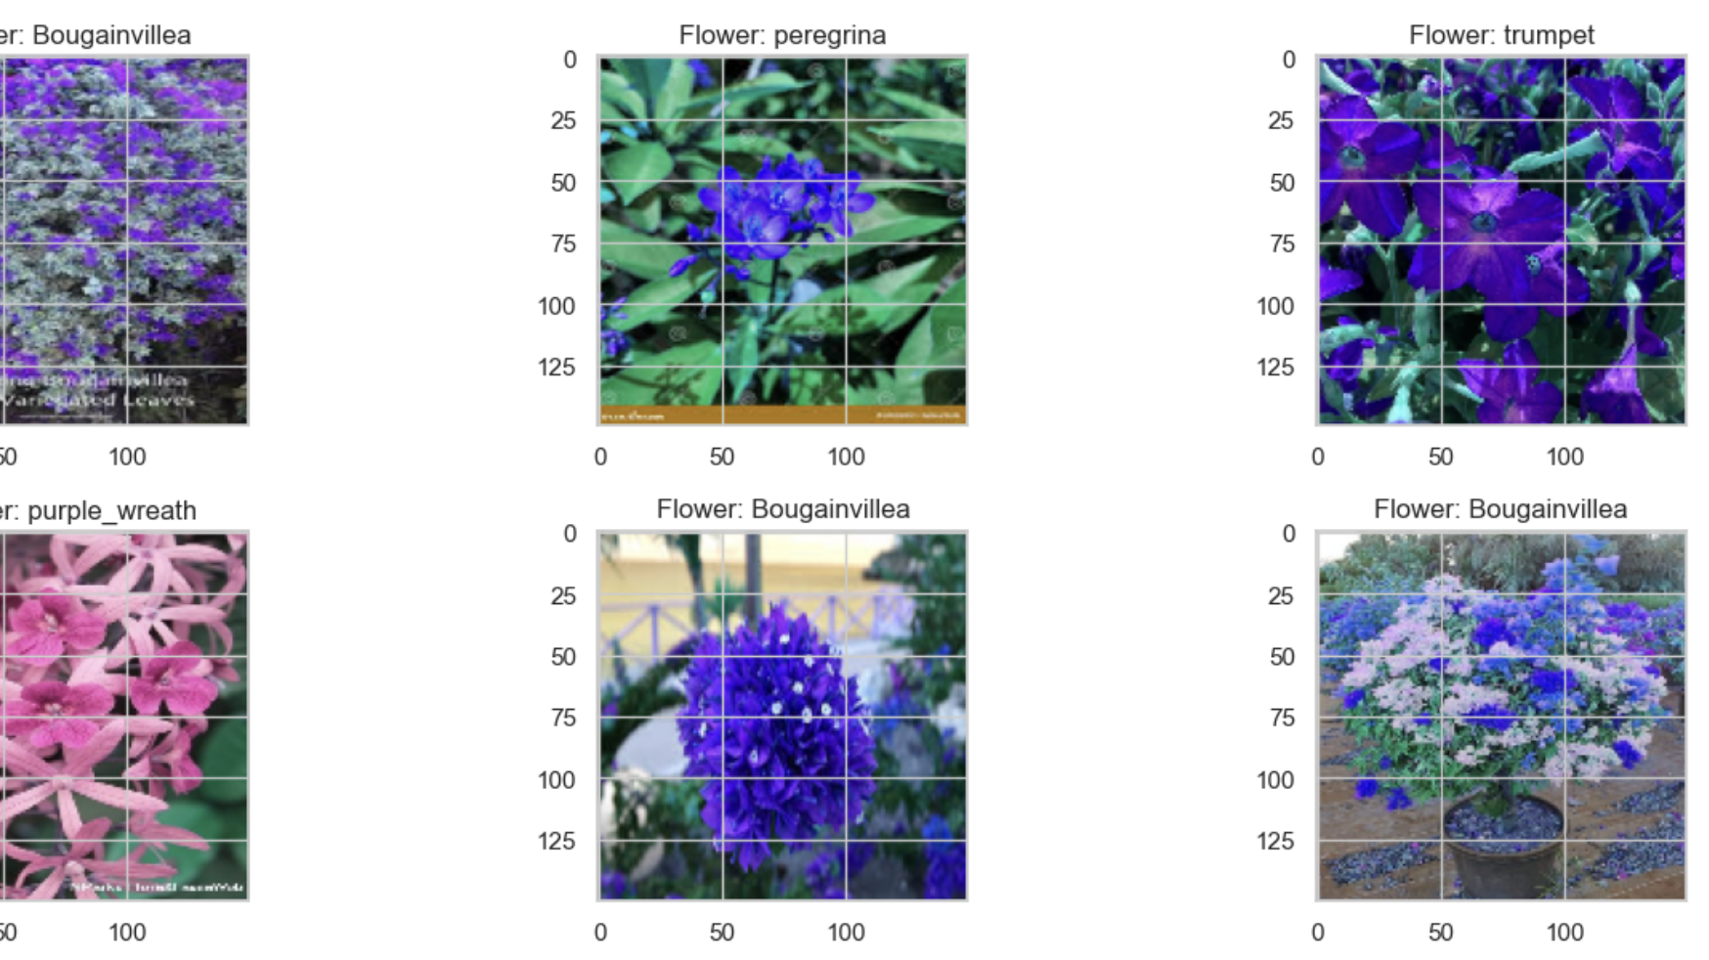
THANK YOU

